Slide 1
Monday 17.03.2025
Student: Matveev Dmitri,
Scientific supervisor: Katyrlo Elena Stanislavovna, professor, department of applied economics

Slide 2
Agenda
Problem outline.
Research design.
Research questions.
Theoretical framework.
Empirical research analysis.
Data overview.
Difference-in-differences: event study.
Model results.
Further questions.

Slide 3
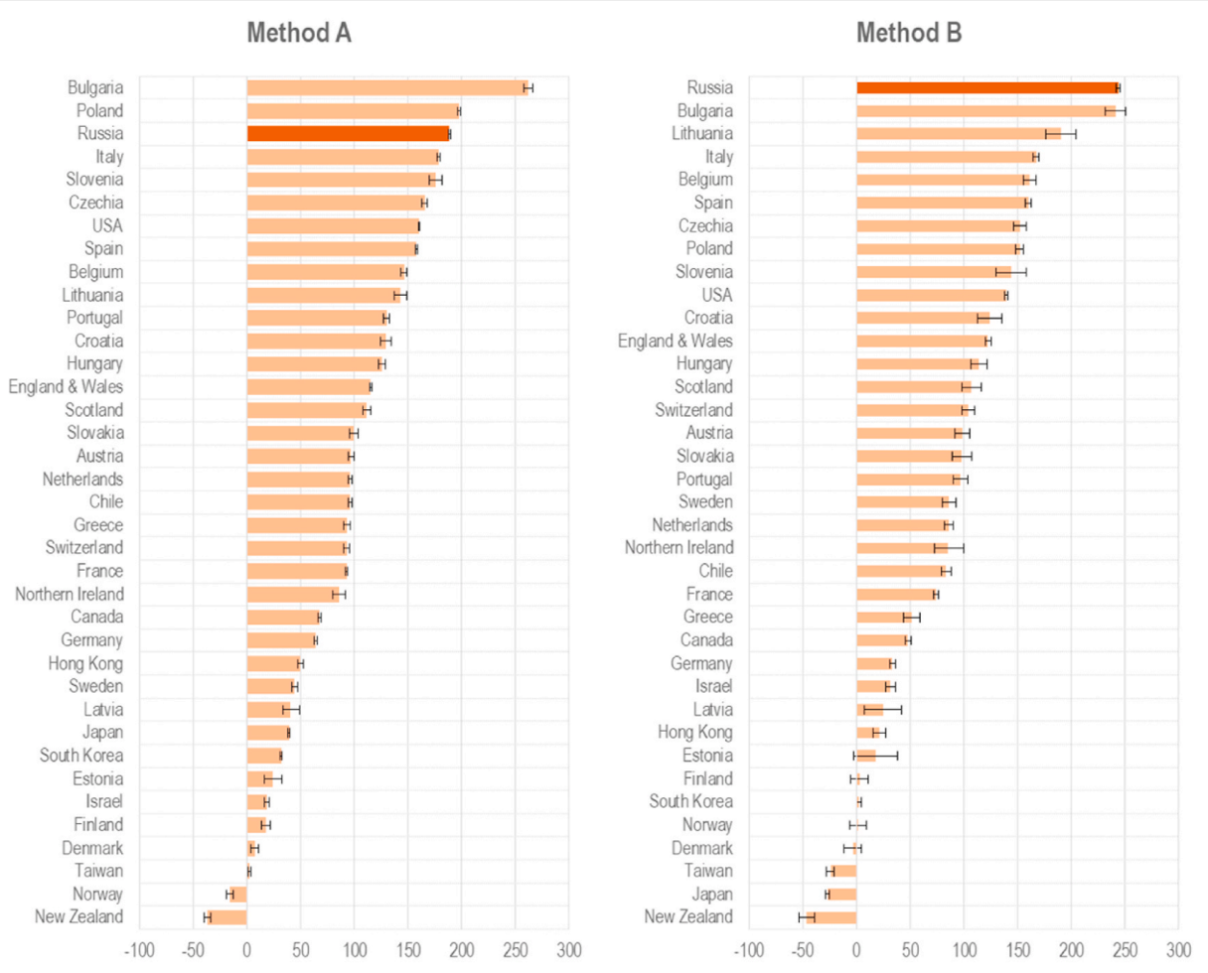
Problem outline
Employment market
Difficulty in adapting to remote work due to lack of accessible technology or accommodations.
Reduced employment opportunities due to economic downturns affecting inclusive hiring practices.
Healthcare Access
Limited access to healthcare due to overwhelmed medical systems prioritizing COVID-19 patients.
Difficulty accessing routine healthcare, therapy, or medication due to lockdowns and restrictions
Increased Health Risks
Greater vulnerability to severe COVID-19 symptoms, especially among individuals with pre-existing conditions.
Educational Barriers
Limited accessibility of online education for students with disabilities.
Disruptions in special education services and support systems.

Slide 4
Research design
Research question
How did COVID-19 restrictions affect the employment status of workers with disabilities compared to non-disabled workers?
Methodology
Difference-in-differences approach for event studies. This approach will help us estimate the causal impact of COVID-19 restrictions on employment outcomes for workers with disabilities.
For measure units we opted to used risk factors mostly because pure income differences may be misleading in DiD framework but yet informative to measure gap differences between people with disabilities and non-disabled.
Objectives
Analyze theoretical approaches that can provide adequate measurements for work related risks between treatment and control groups,
Comparison of employment trends before and after covid restrictions between workers with and without disabilities to determine whether disparities widened,
Develop DiD model to inspect casual effects of Covid 19 restriction on labor market,
Develop policy recommendations to lower risks for endangered work groups

Slide 5
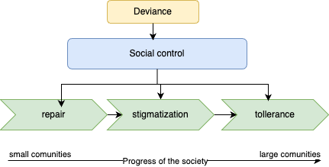
Theory overview
Social control framework
Human capital framework
Risk assessment framework
sociological framework in which individuals and societies regulate behavior to conform to societal norms and values. This regulation occurs through a variety of mechanisms, including repair, stigmatization, and tolerance
Human capital theory revolves around the concept that investment in education and training enhances an individual's productivity. The theory is based on the principles that much like physical capital, human capital involves costs, such as tuition and foregone earnings, but yields benefits, particularly higher anticipated income
combination of several approaches studying distinct characteristics that contribute to a comprehensive analysis of economic and health-related risks. The risk assessment framework developed identifies several vital risk factors. These include economic risks, such as the increased likelihood of disabled workers being employed in "shutdown industries" heavily impacted by COVID-19 restrictions like retail or accommodati

Slide 6
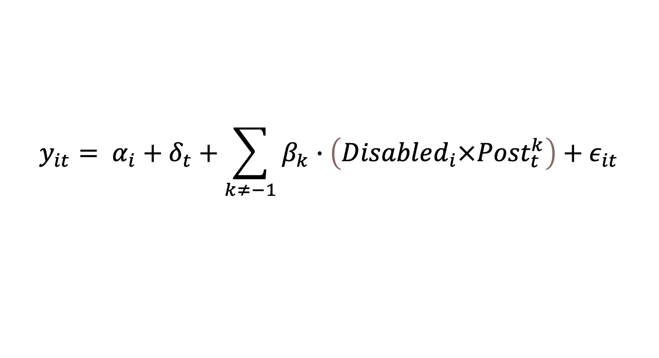
Methodology
Base DiD model
$$y_{it}= α_{i}+δ_{t}+\sum_{k≠−1}^{ }{β_{k}}∙\left(Disabled_{i}×{Post}_{t}^{k}\right)+ε_{it}$$
difference-in-differences (DiD) event study design with estimation through a linear probability model (LPM). The primary objective is to assess how the likelihood of employment evolves before and after the onset of disability, relative to a control group of normotypical individuals.

Slide 7
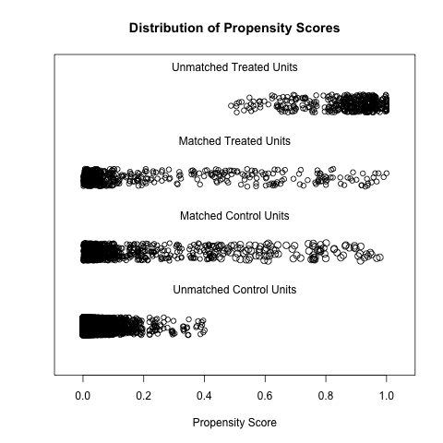
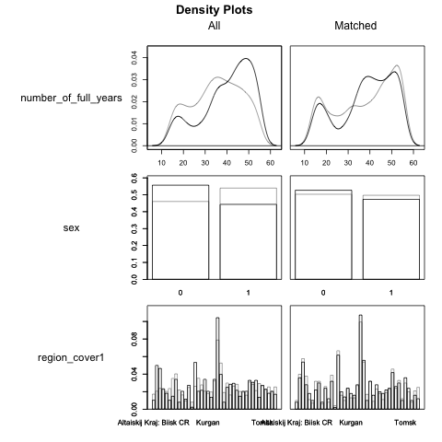
Methodology
Propensity score matching
Before PSM
 | count | percentage
disabled | 882 | 3%
Non-disabled | 27628 | 97%
After PSM
 | count | percentage
disabled | 503 | 36%
Non-disabled | 898 | 64%
key assumption in DiD is the parallel trends assumption, which requires that, in the absence of treatment, the treatment and control groups would follow similar trends over time. Unbalanced groups—where the treatment and control groups differ significantly in size, composition, or pre-treatment characteristics—can severely violate this assumption, leading to biased estimates

Slide 8
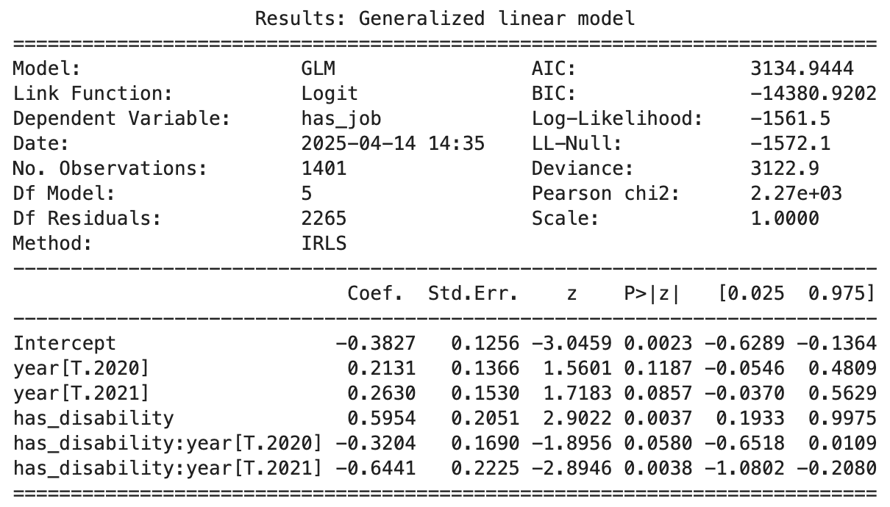
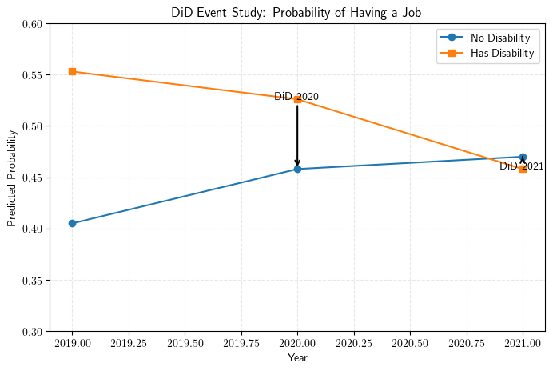
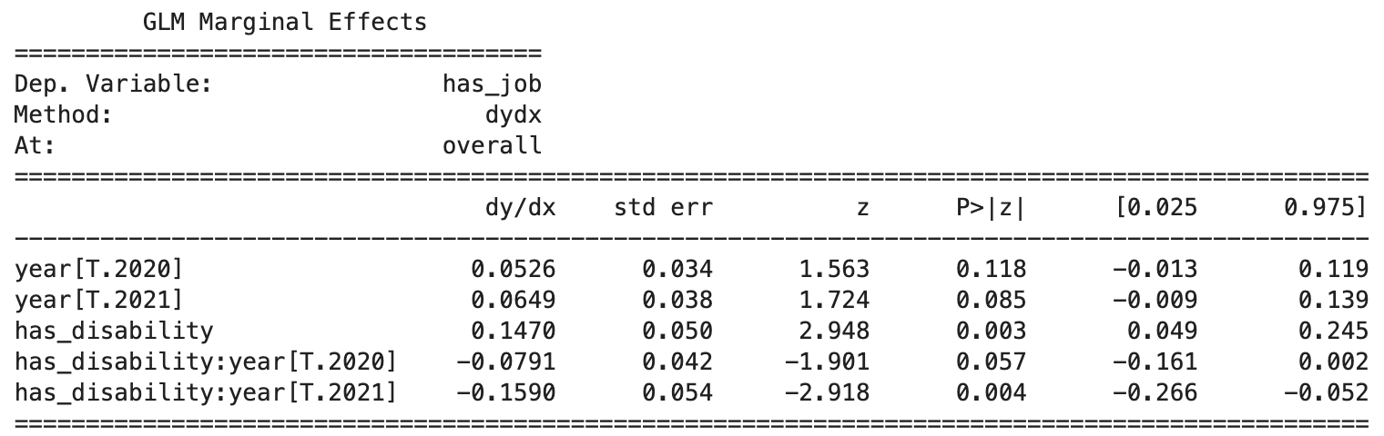
Results

